Slide 1
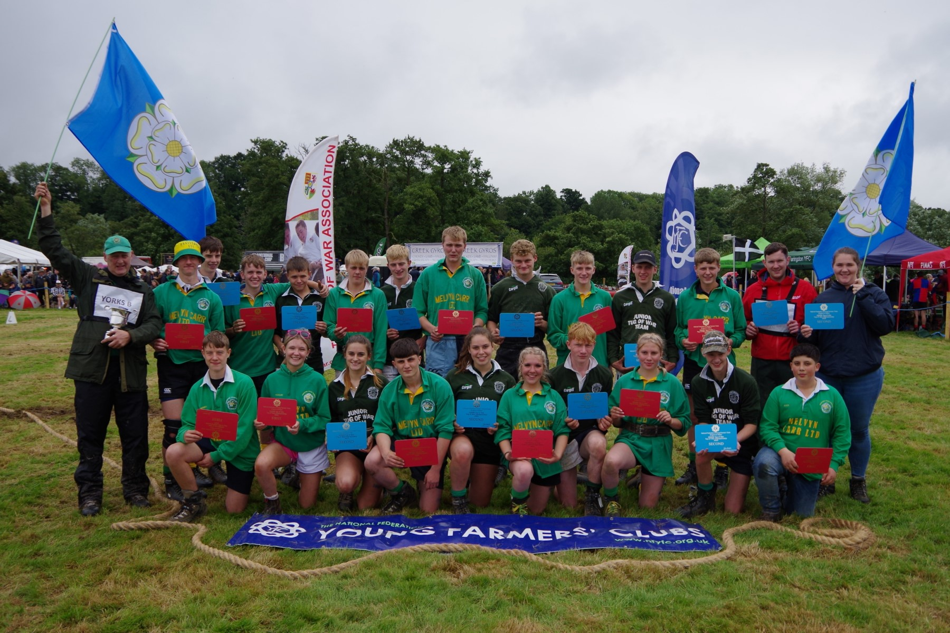

Winter Programme Ideas
September 2023

Slide 2
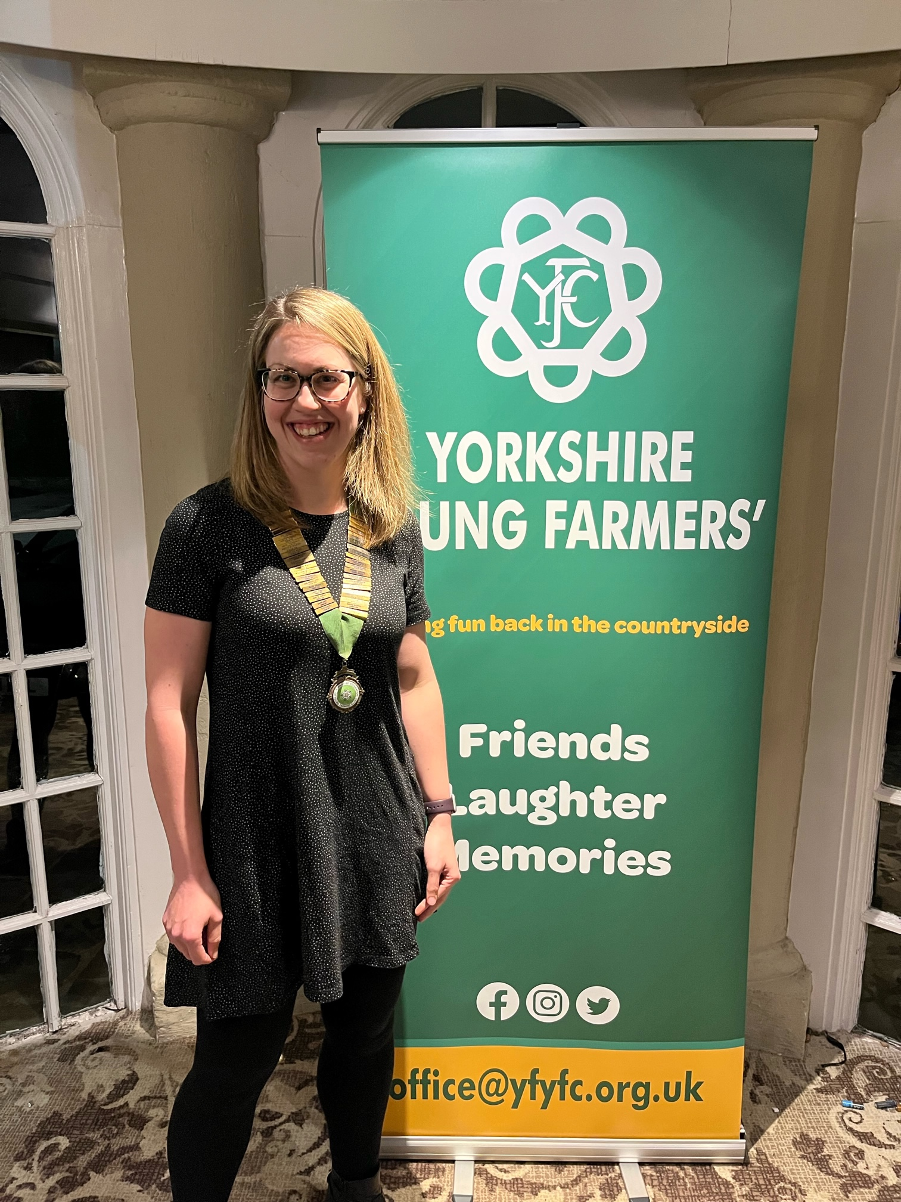

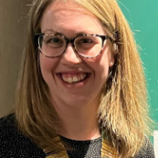
Preparing your Club Programme
Get ready for the new membership year!
Kirsty Chapple
YFYFC Chairman

Slide 3
Contents
How to plan your club programme and considerations
Design and publishing
Winter Programme Ideas
YFYFC Competitions and Events
National Young Farmers' Week
Digital Membership

Slide 4

How to plan your club programme and considerations
Planning
Collect ideas of club meetings from members
Meet as a small group to plan the programme
Plan for the next 3/6 months
Share the workload of arranging visits
Contact venues in good time

Slide 5
How to plan your club programme and considerations
Considerations
Ensure the programme is what members are interested in!
Create a varied and diverse programme
Learn about new subjects and develop fresh skills
Spread costly meetings over the programme
When are District & County Competitions
  Do members need any training before? – ask County Office for help!
  Do you need a practice as a Club the week before?
Over 18s meeting? – keeping your older members engaged

Slide 6
Design and publishing your club’s programme
Preparation & Publishing
Prepare ahead
Make it look good – you’re competing with other youth organisations
Make sure it’s “pin-able” – members fridge/board – this lets the whole household see!
Include useful contacts and content
Include District/County events, competitions, meetings etc

Slide 7
Design and publishing your club’s programme
Printing
Need lots of copies? check out www.instantprint.co.uk
Ask a local business – add their logo to the programme in return for printing
Struggling to get someone to print it – ask County Office to print out and post to the Club Programme Secretary*
*costs and postage will be chargeable to the club

Slide 8
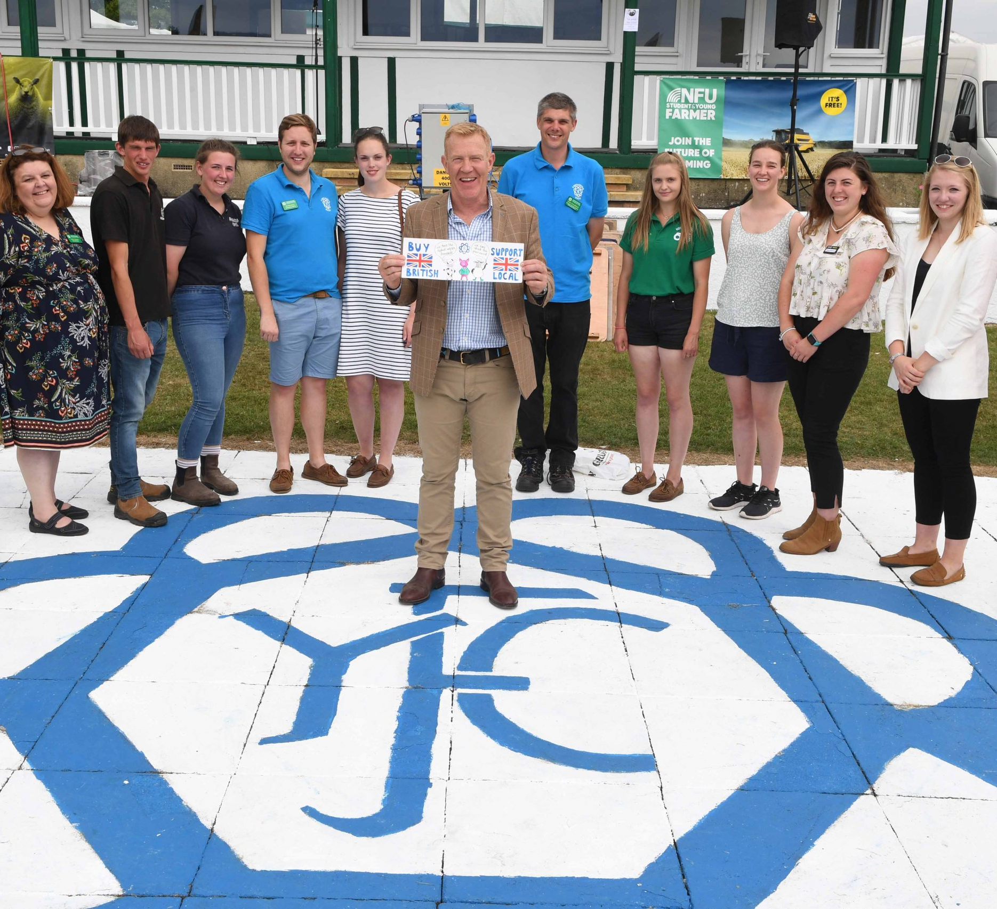
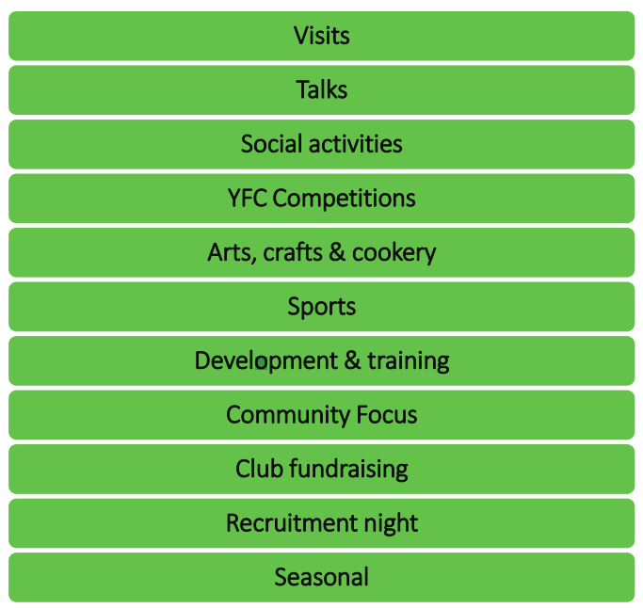
Winter Programme Ideas
Retain you existing members!

Slide 9
Winter Programme Ideas
Visits
Ghost walk
Weekend Farm walk
Machinery dealership tour
Chocolatier
Ice cream parlour
Activity centre
Escape Room
Business Meeting
Senior – Brewery/distillery tour
Animal Feed Manufacturer
Cheese Maker
Farm shop tour
Butchery / pie maker
Stone carving
Orchard/Cider Press
Sally Farm – Vencomatic (eggs)
Local dairy
Local Fire Station
Other Club/District Nights
Blacksmith/Farrier
Racehorse Yard
Talks
Air Ambulance
Cancer Support Group
Local museum
Fire, Police, Mountain Rescue
Beekeepers Association
Guide Dogs
Yorkshire Water
Yorkshire Wildlife Trust
Samaritans
Farming Community Network
Addington Fund
Local hospice
Precision Farming
Local NFU
RABI – interactive games
Agronomist
Vets
Armed Forces
Farm/Estate Manager
Florist
Gamekeeper
Journalist
YFC Travel

Slide 10
Winter Programme Ideas
Social Activities
Club social night
Board Games
“Family Fortunes”
Quiz night vs Advisory Committee
Ice-breaker challenges
Guess the weights
Speed Dating
Club/District socials
Film/Movie Night
Chocolate Night (blind tasting, quiz, games)
I’m a YF, get me out of here!
Club/District Bonfire
YFC Competitions
Novelty Judging
Stock Judging
Public Speaking
Machinery Valuation
Rally comps & prep
Ploughing Match
Gator Handling
Pallet Challenge
Arts, Crafts & Cookery
Pebble painting & trail laying
Pottery painting
Flower arranging
Ready steady cook
Group art
Scarecrow making
Pizza making
Club “bake-off”

Slide 11
Winter Programme Ideas
Club Fundraising Ideas
Bric-a-brac/Cake Stall
Christmas raffle/draw
Charity auction
Supermarket bag pack
Domino drive
Ploughing match
Sponsored night walk
Carol Singing
Christmas Tree Collection
Much chuck
Bingo
Race Night
Recruitment Night
Ice breaker challenges
Team building nights
Sports
Open Night
Seasonal
Pumpkin Carving
Harvest Festival
Remembrance Day
Christmas Wreath/cake making
Pantomime/Theatre Trip
Christmas Meal
Pancake Day
Chinese New Year
Easter Egg Decorating

Slide 12
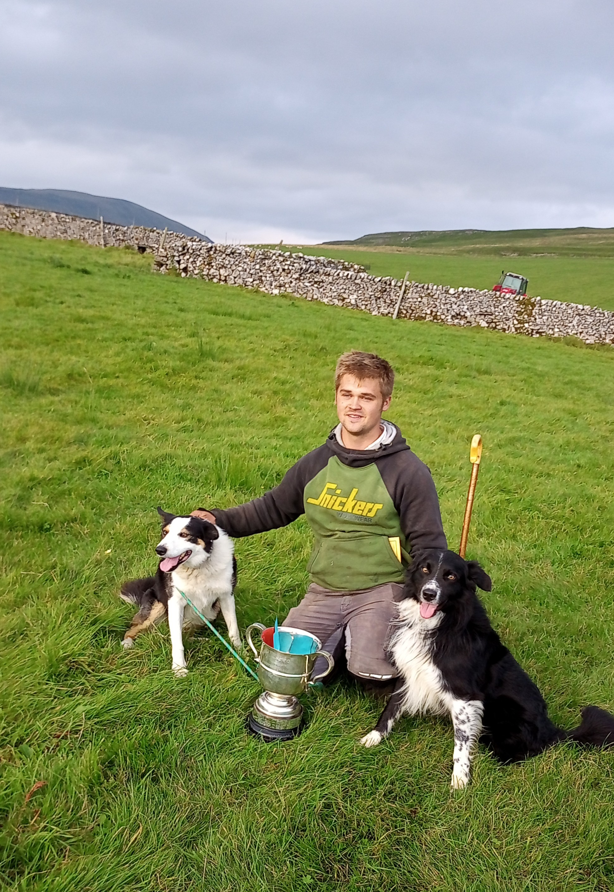



Upcoming YFYFC Competitions
Saturday 7th October 2023
Sunday 29th October 2023
Sunday 5th November 2023
Rural Skills
Day
Wigglesworth, Skipton
Live & Carcase Competition
J&E Medcalfs, Halifax
Off Roading Challenge
Rudding Park,
Harrogate

Slide 13
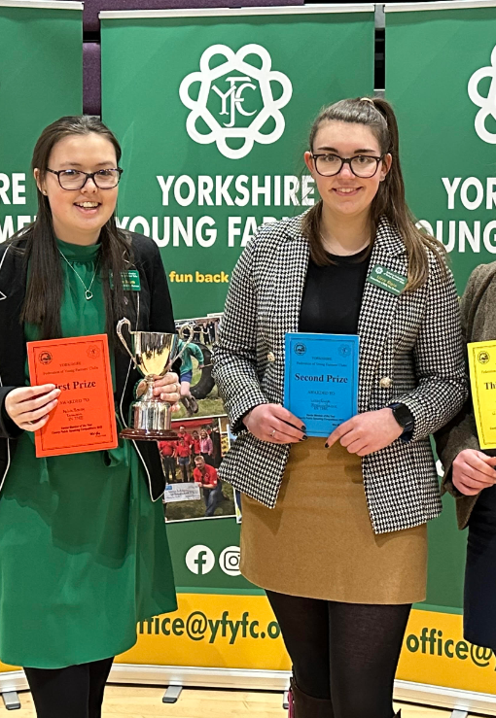



Upcoming YFYFC Competitions
Sunday 26th November 2023
Thursday 7th December 2023
Sunday 21st January 2024
County Sports
Venue tbc
County Bowling
Ten Pin, York
Public Speaking
Harrogate High School

Slide 14
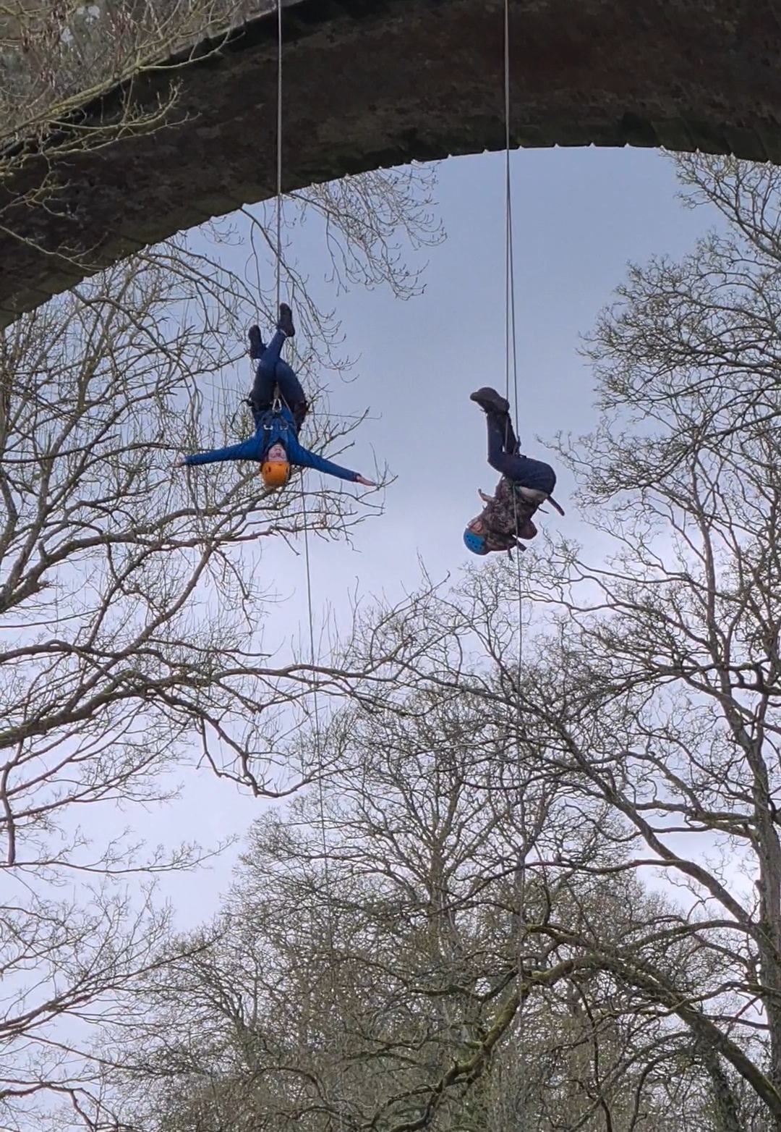



Upcoming YFYFC Events
Friday 13th October 2023
Saturday 21st & Sunday 22nd October 2023
Friday 27th October 2023
Quiz Night
The Anchor Inn, Whixley
Junior Activity Days
Carlton Lodge, Thirsk
Halloween Dance
Kooky Nightclub, Skipton

Slide 15
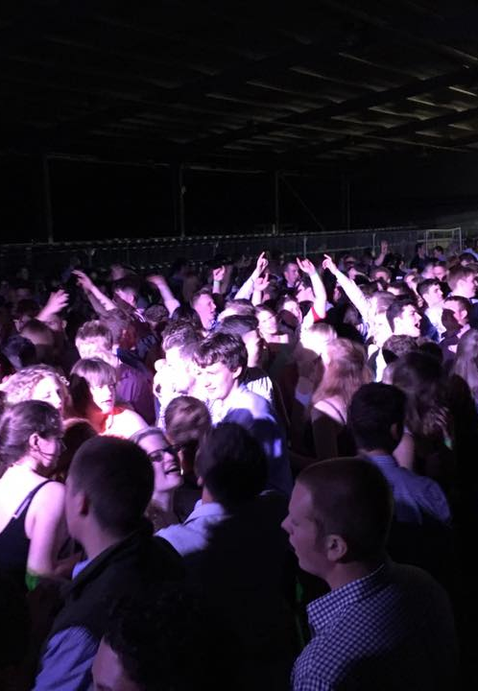



Upcoming YFYFC Events
December 2023
tbc
Sunday 28th January 2024
Throughout 2024
Christmas Dance
Club Amadeus
Northallerton
Club Officers Training
Bridge Inn, Walshford
YFYFC celebrates
the 50th
Anniversary Year

Slide 16
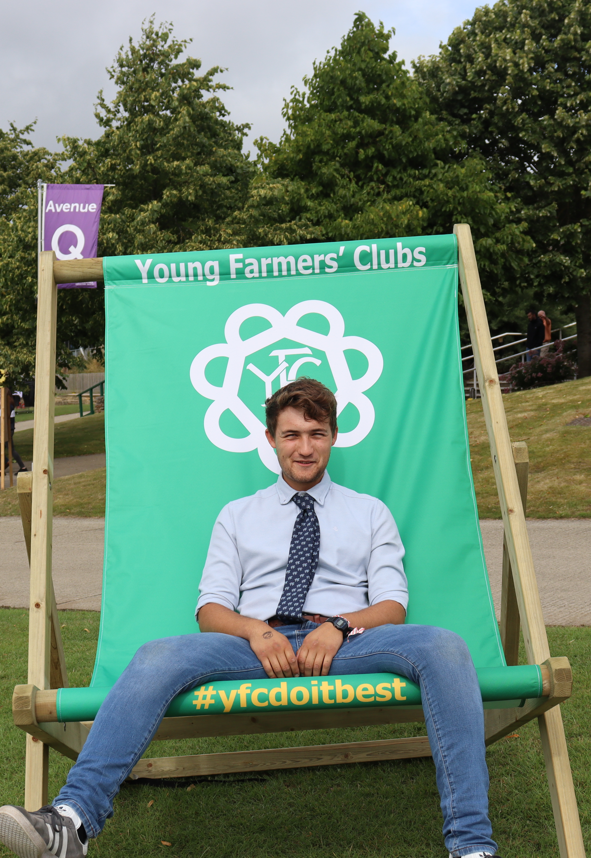


Upcoming YFYFC Meetings
Thursday 14th September 2023
@ 7.30pm
Thursday 28th September 2023
@ 7.30pm
Thursday 12th October 2023 @7.30pm
Events, Finance & Marketing Committee
County Office
Competitions & Skills Committee
County Office
Events, Finance & Marketing Committee
County Office

Slide 17
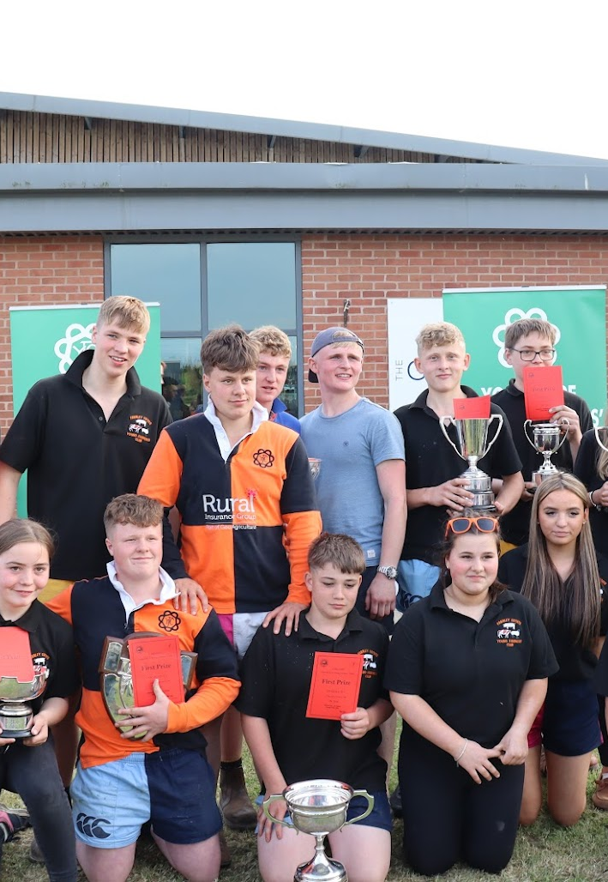
Upcoming YFYFC Meetings
Thursday 26th October 2023
@ 7.30pm
Thursday 23rd November 2023
@ 7.30pm
Thursday 11th January 2024 @7.30pm
Executive Committee
Pannal Golf Club
Competitions & Skills Committee
County Office
Events, Finance & Marketing Committee
County Office

Slide 18
Get the latest information
www.yfyfc.org.uk/programme-ideas/

Slide 19
National Young Farmers’ Week 2023
16th – 20th October 2023
More details coming soon!

Slide 20

Get in touch
County Office County Chairman
office@yfyfc.org.uk kirsty.searby@gmail.com
01423 546170 07791 155179
www.yfyfc.org.uk

Slide 21

Digital Membership
The new membership year starts on 1st September 2023

Slide 22
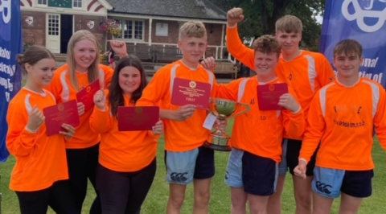
Thank You!
Keep in touch

